Slide 1


Instructor Resources
Chapter 13 Figures
Cover photo: BeautyStock – stock.adobe.com.

Slide 2
Chapter 13
Navigation, Communication, and Electronic Flight Control Systems

Slide 3
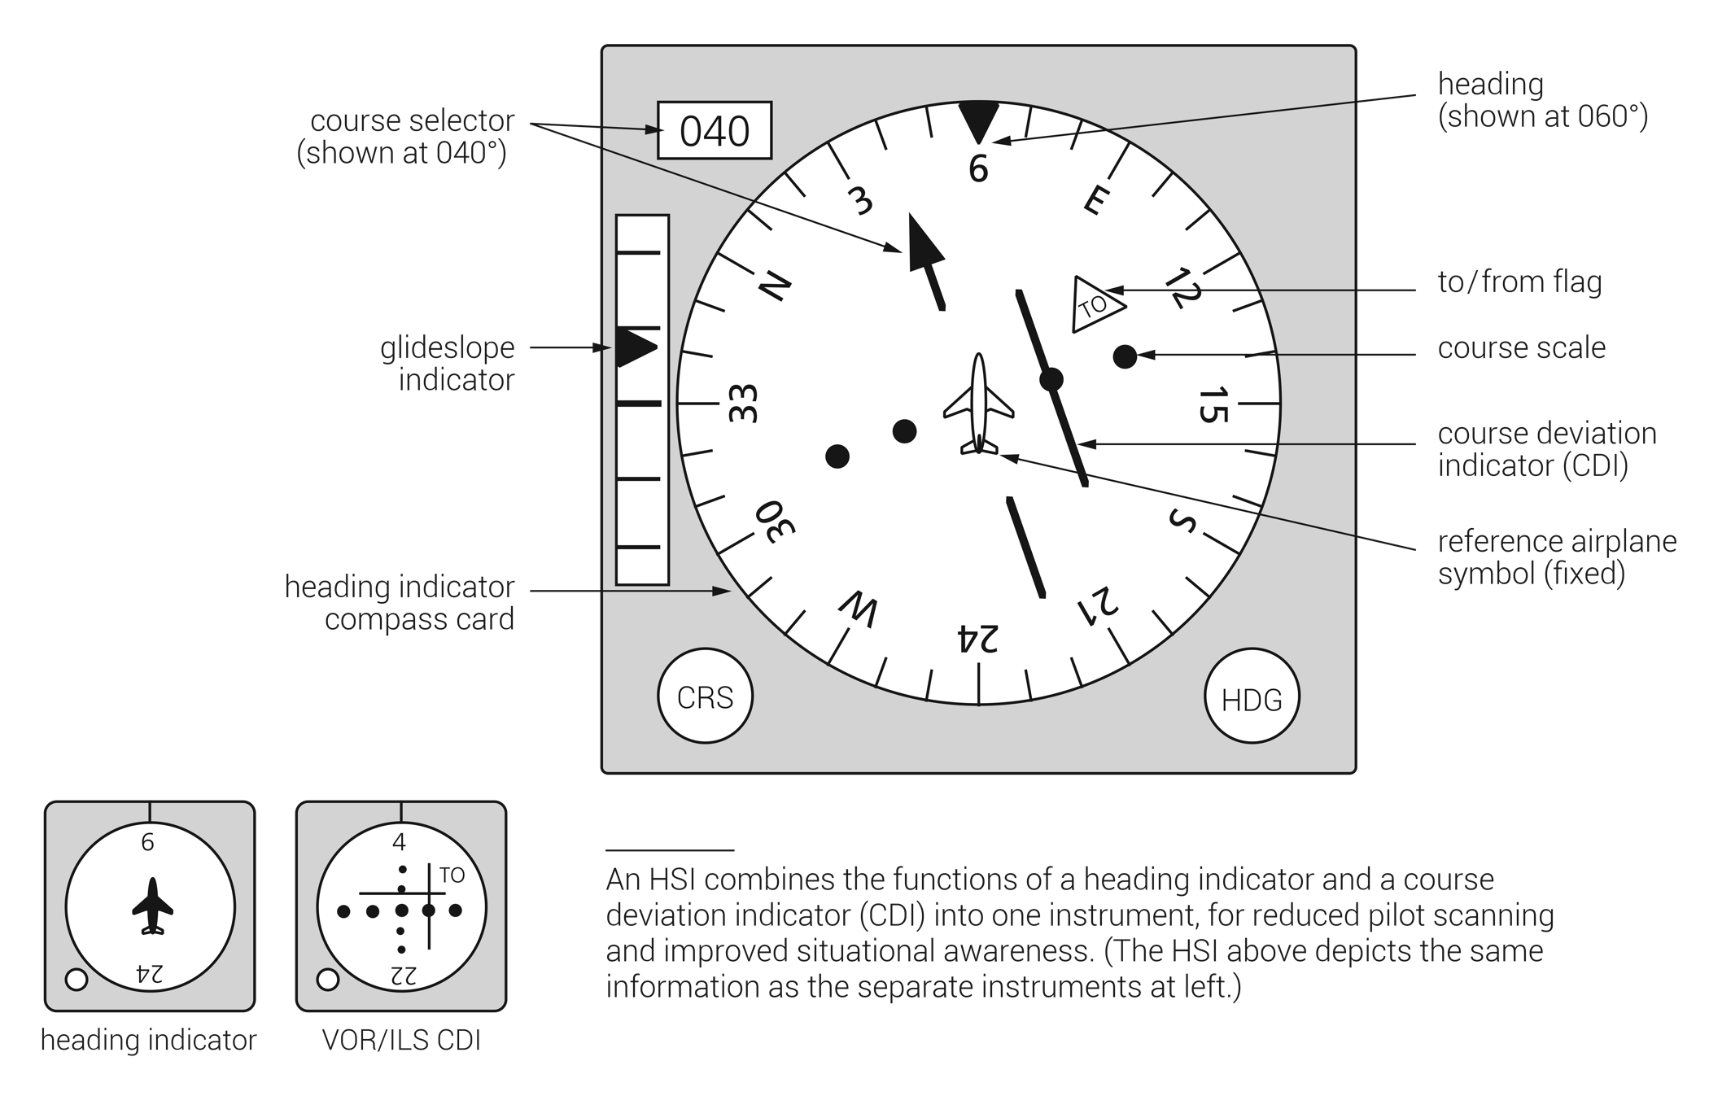
FIGURE 13.1
HSI (horizontal situation indicator).

Slide 4
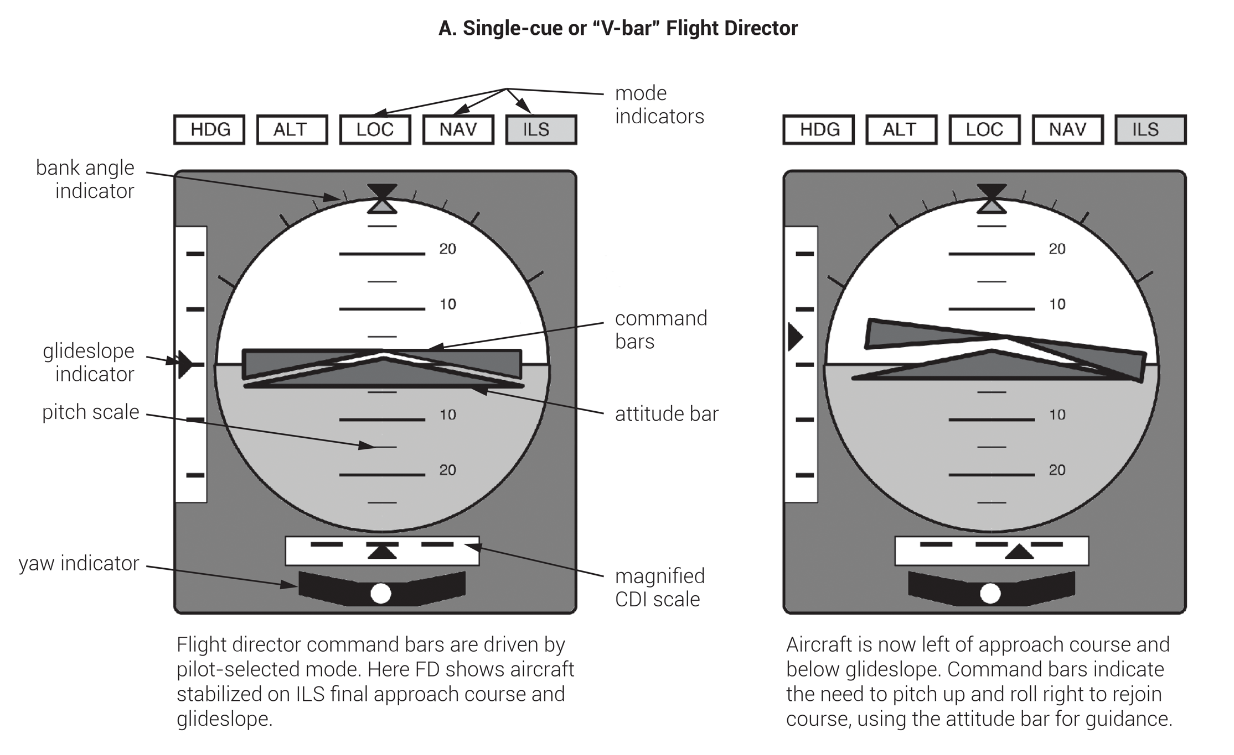
(continued)
FIGURE 13.2
(1 of 2)
(A) Single-cue flight director versus (B) dual-cue flight director.

Slide 5
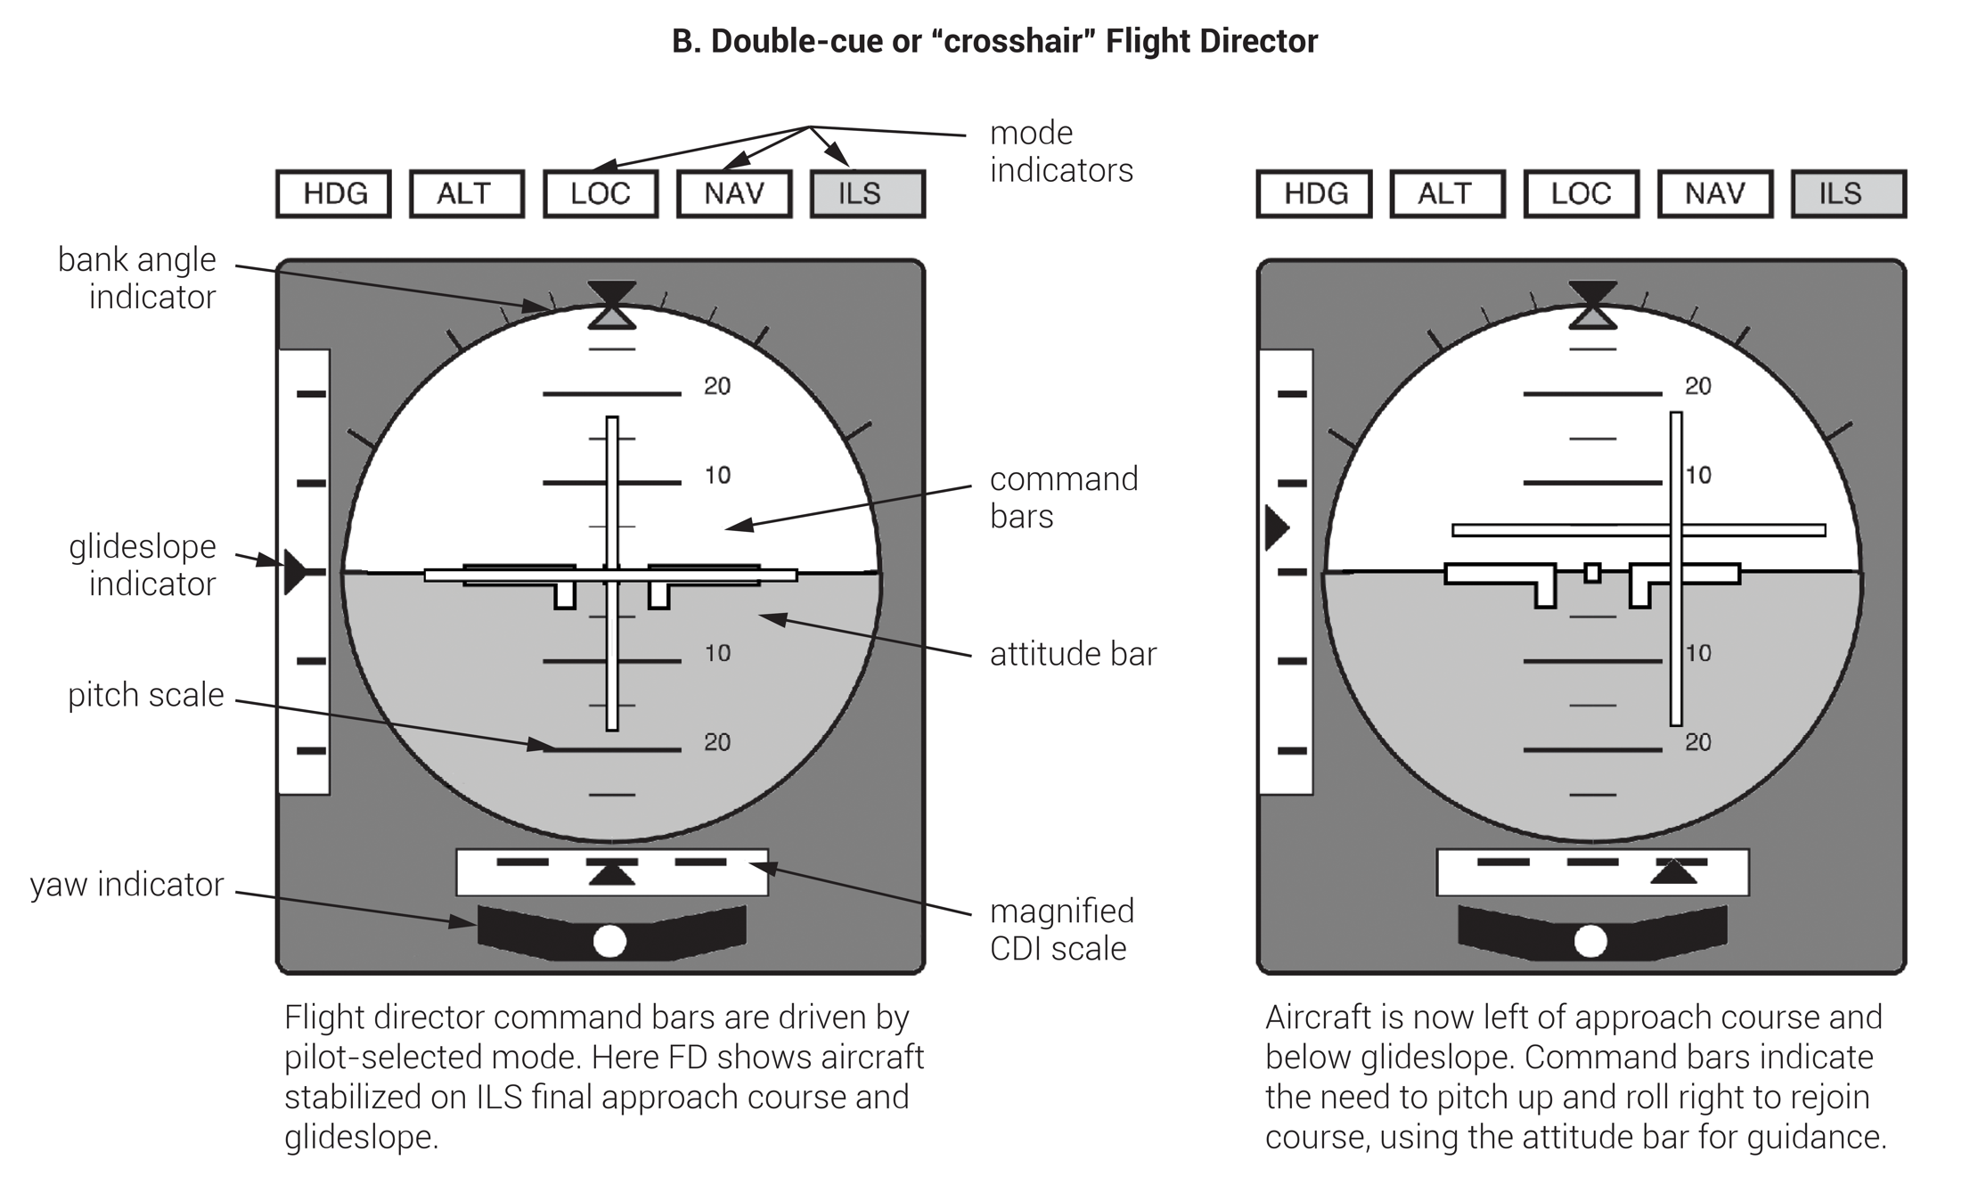
FIGURE 13.2
(2 of 2)
(A) Single-cue flight director versus (B) dual-cue flight director.

Slide 6
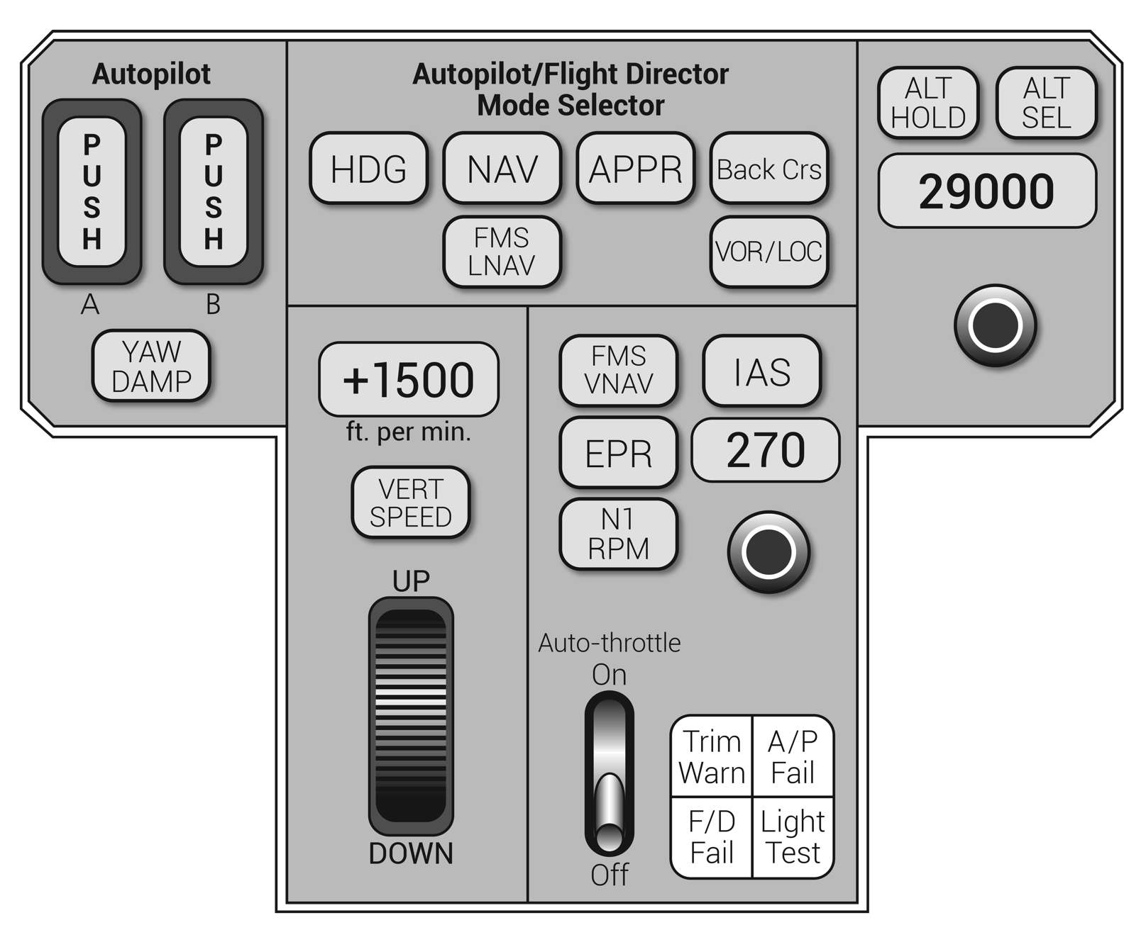
FIGURE 13.3
Autopilot and flight director panel mode selectors.

Slide 7
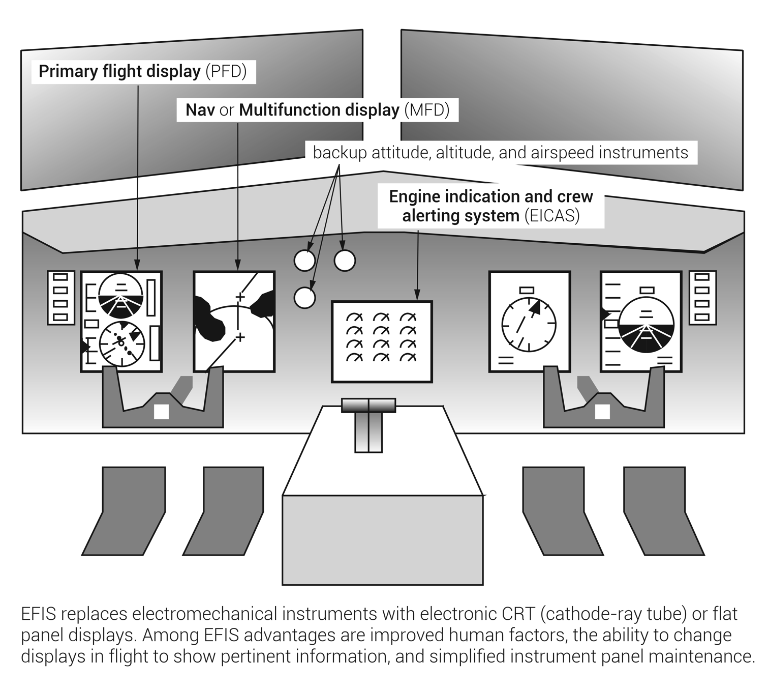
FIGURE 13.4
EFIS (electronic flight instrumentation system).

Slide 8
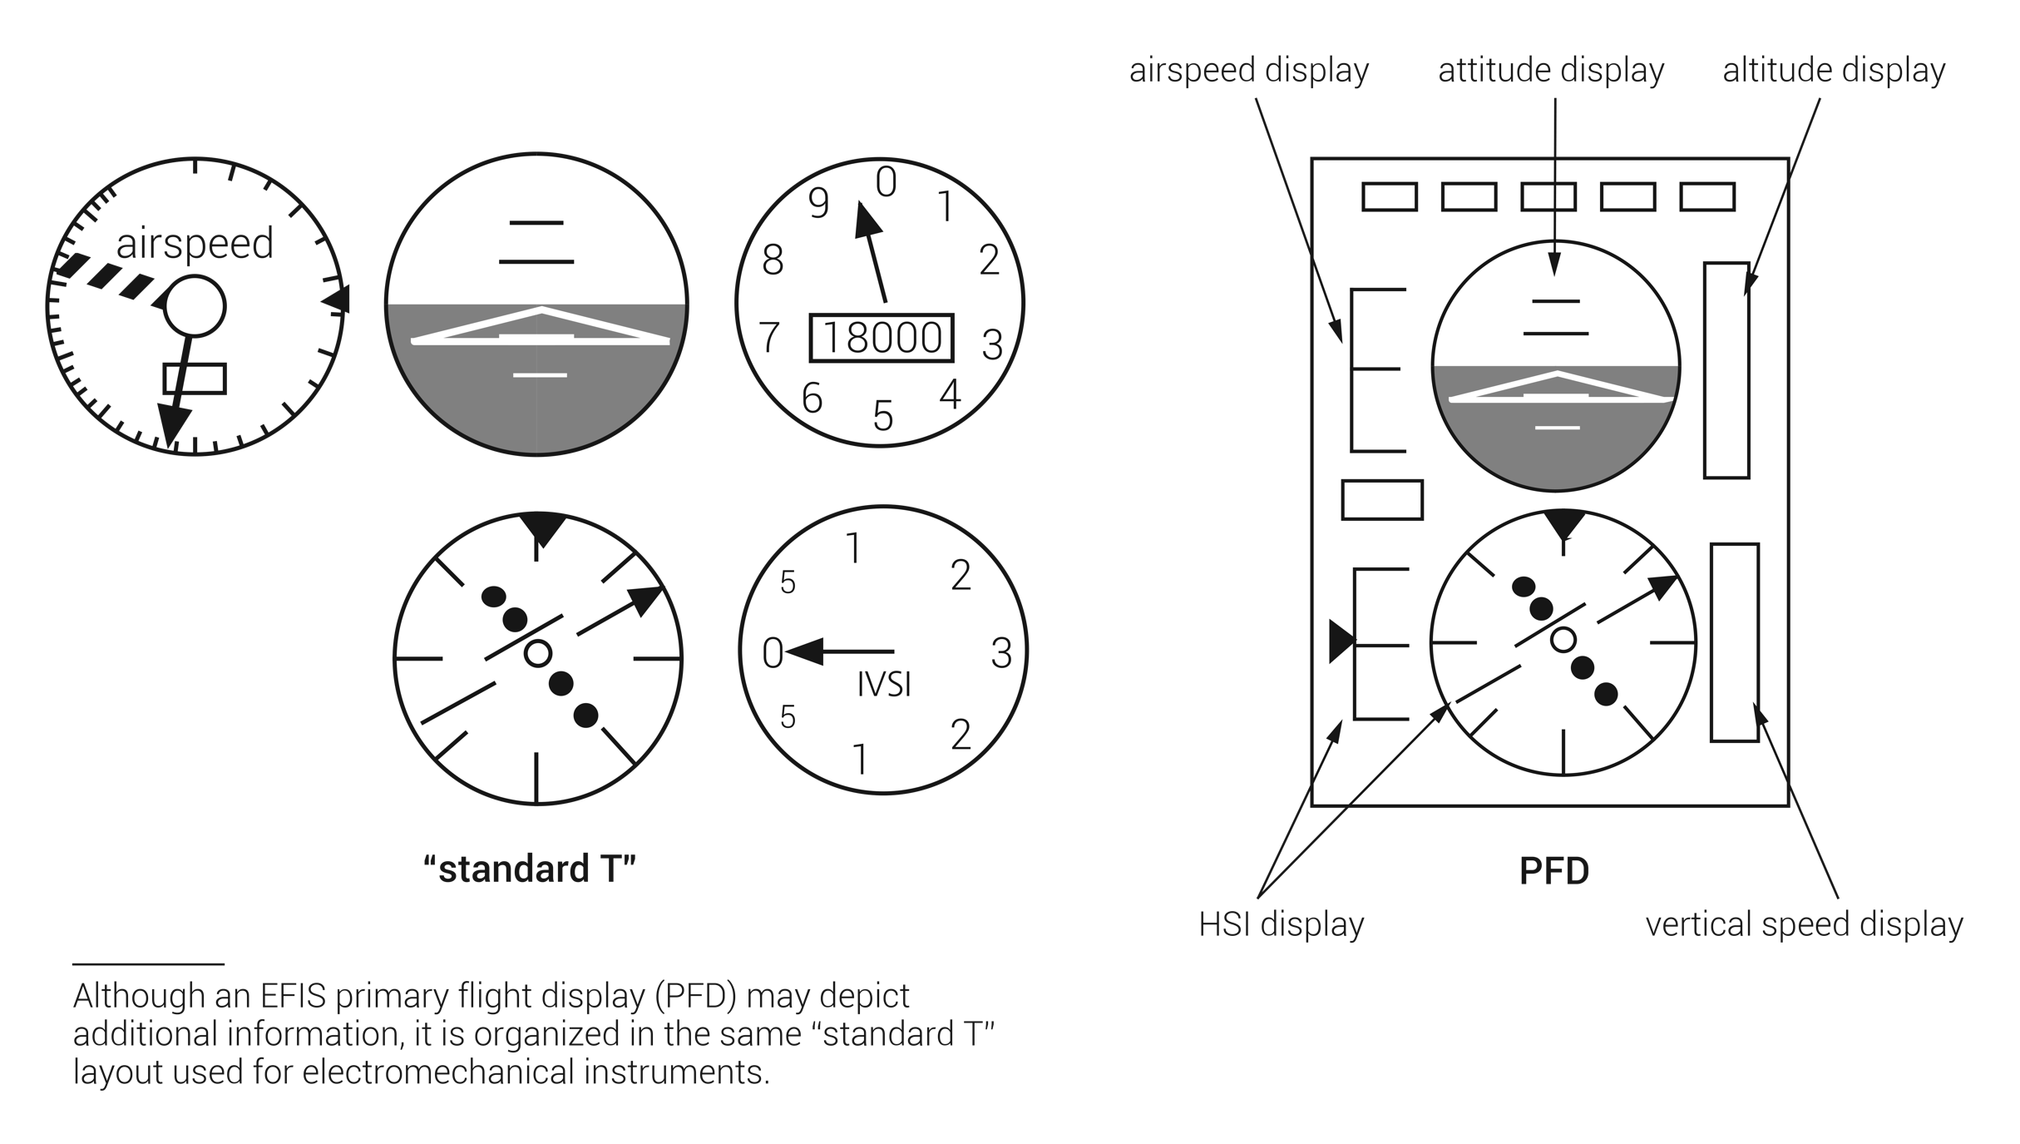
FIGURE 13.5
EFIS primary flight display (PFD).

Slide 9
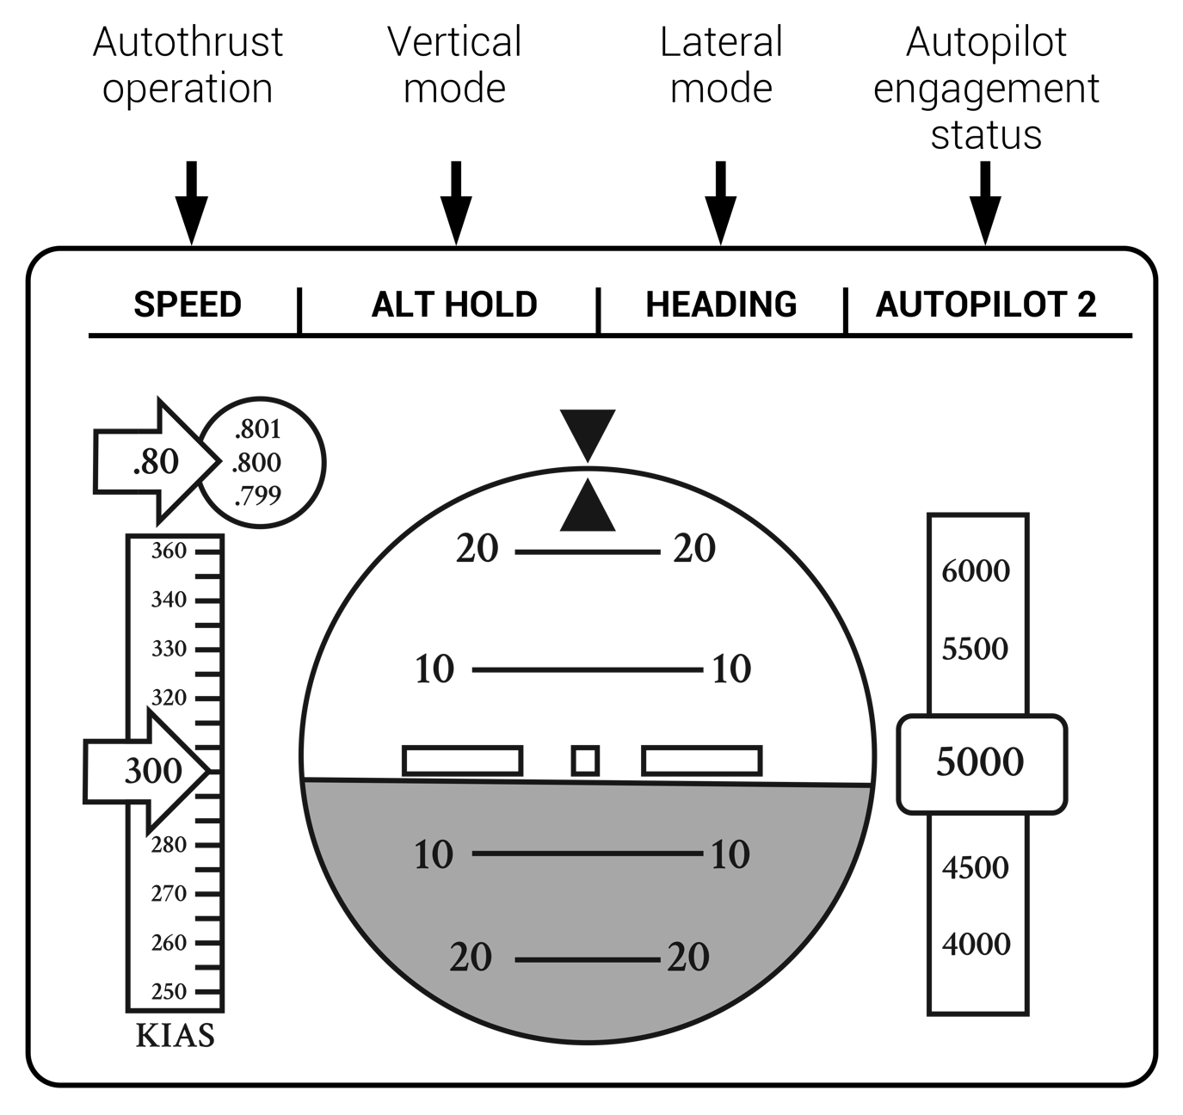
FIGURE 13.6
Flight mode annunciator (FMA).

Slide 10
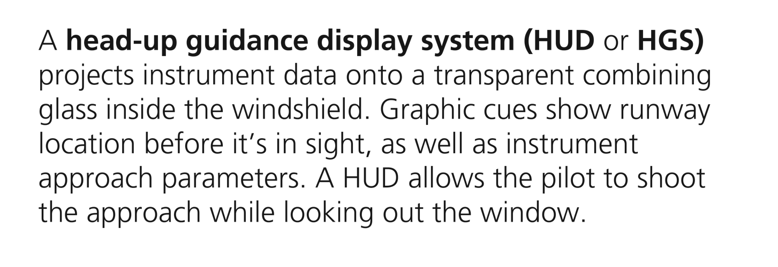
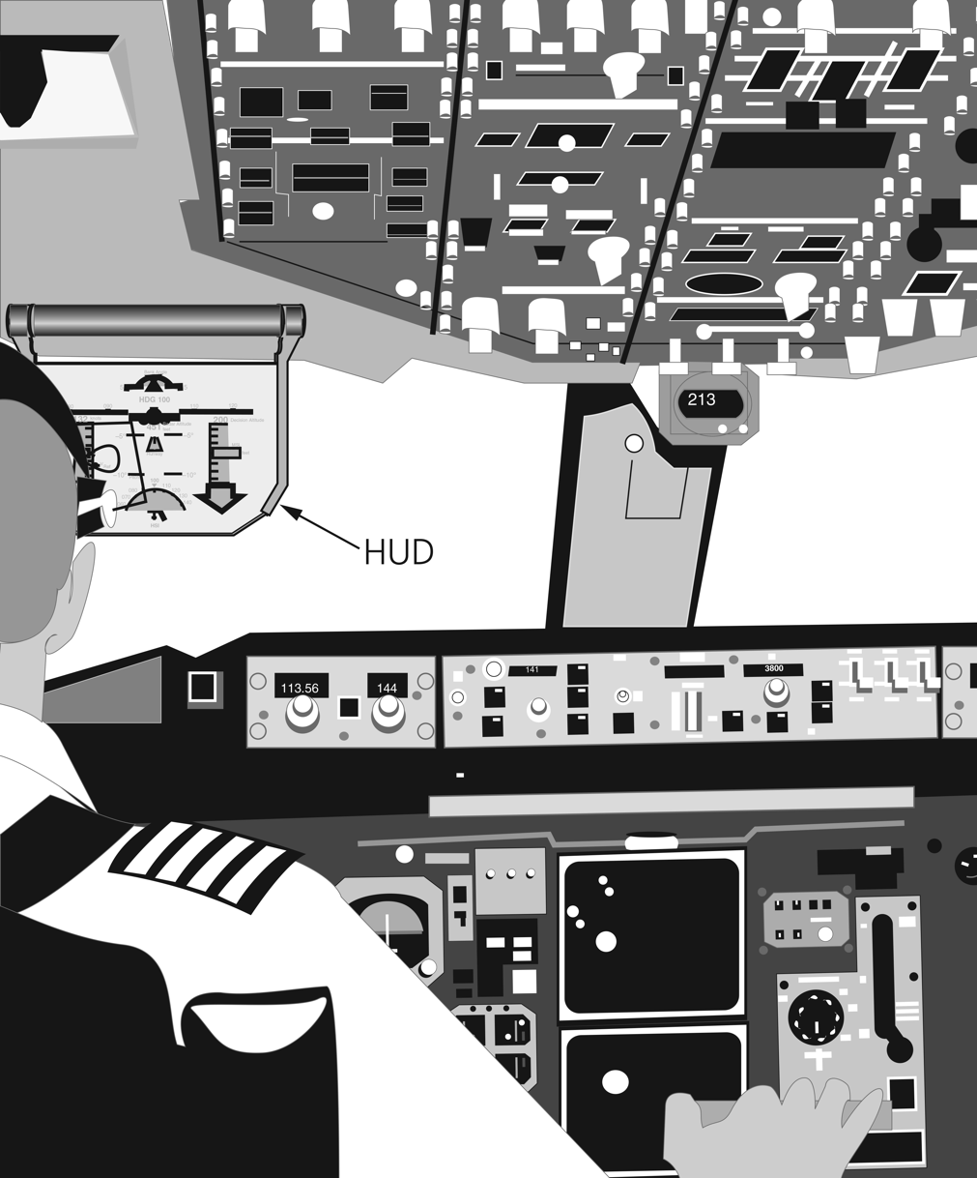
FIGURE 13.7
HUD or HGS.

Slide 11
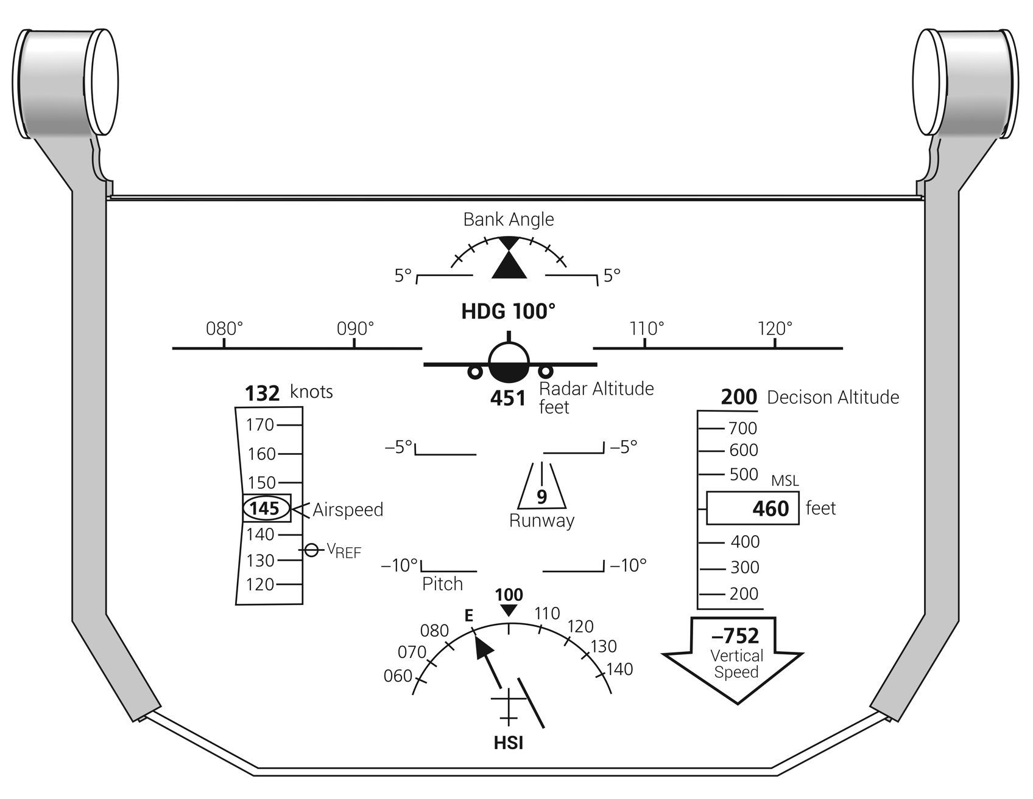
FIGURE 13.8
Head-up guidance system (HUD or HGS) symbology.

Slide 12
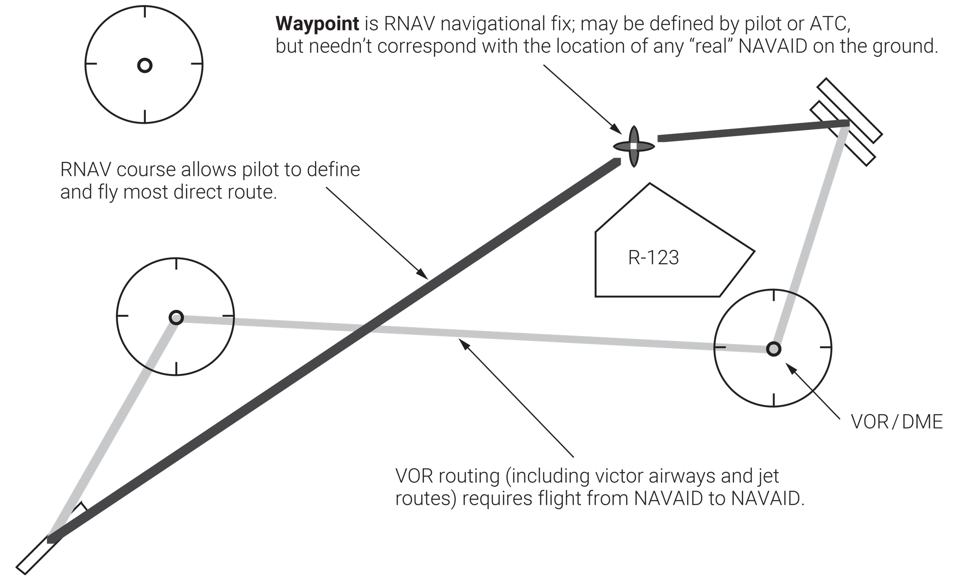
FIGURE 13.9
RNAV (area navigation) course versus VOR flight plan.

Slide 13
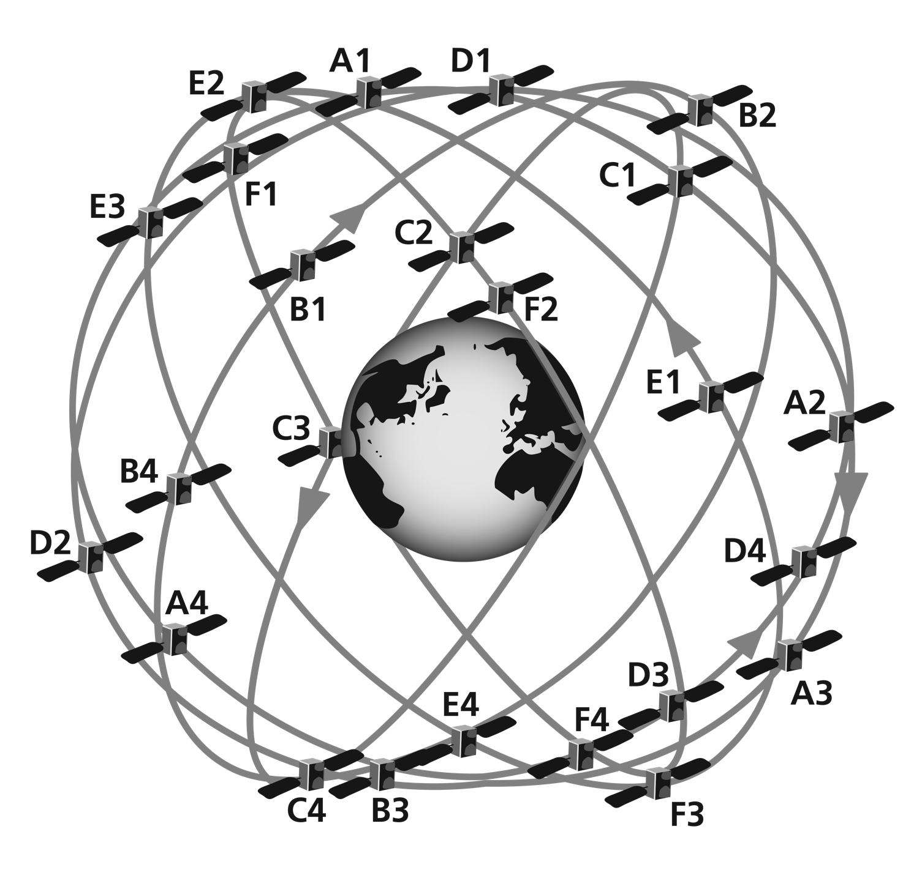
FIGURE 13.10
Global positioning system (GPS).

Slide 14
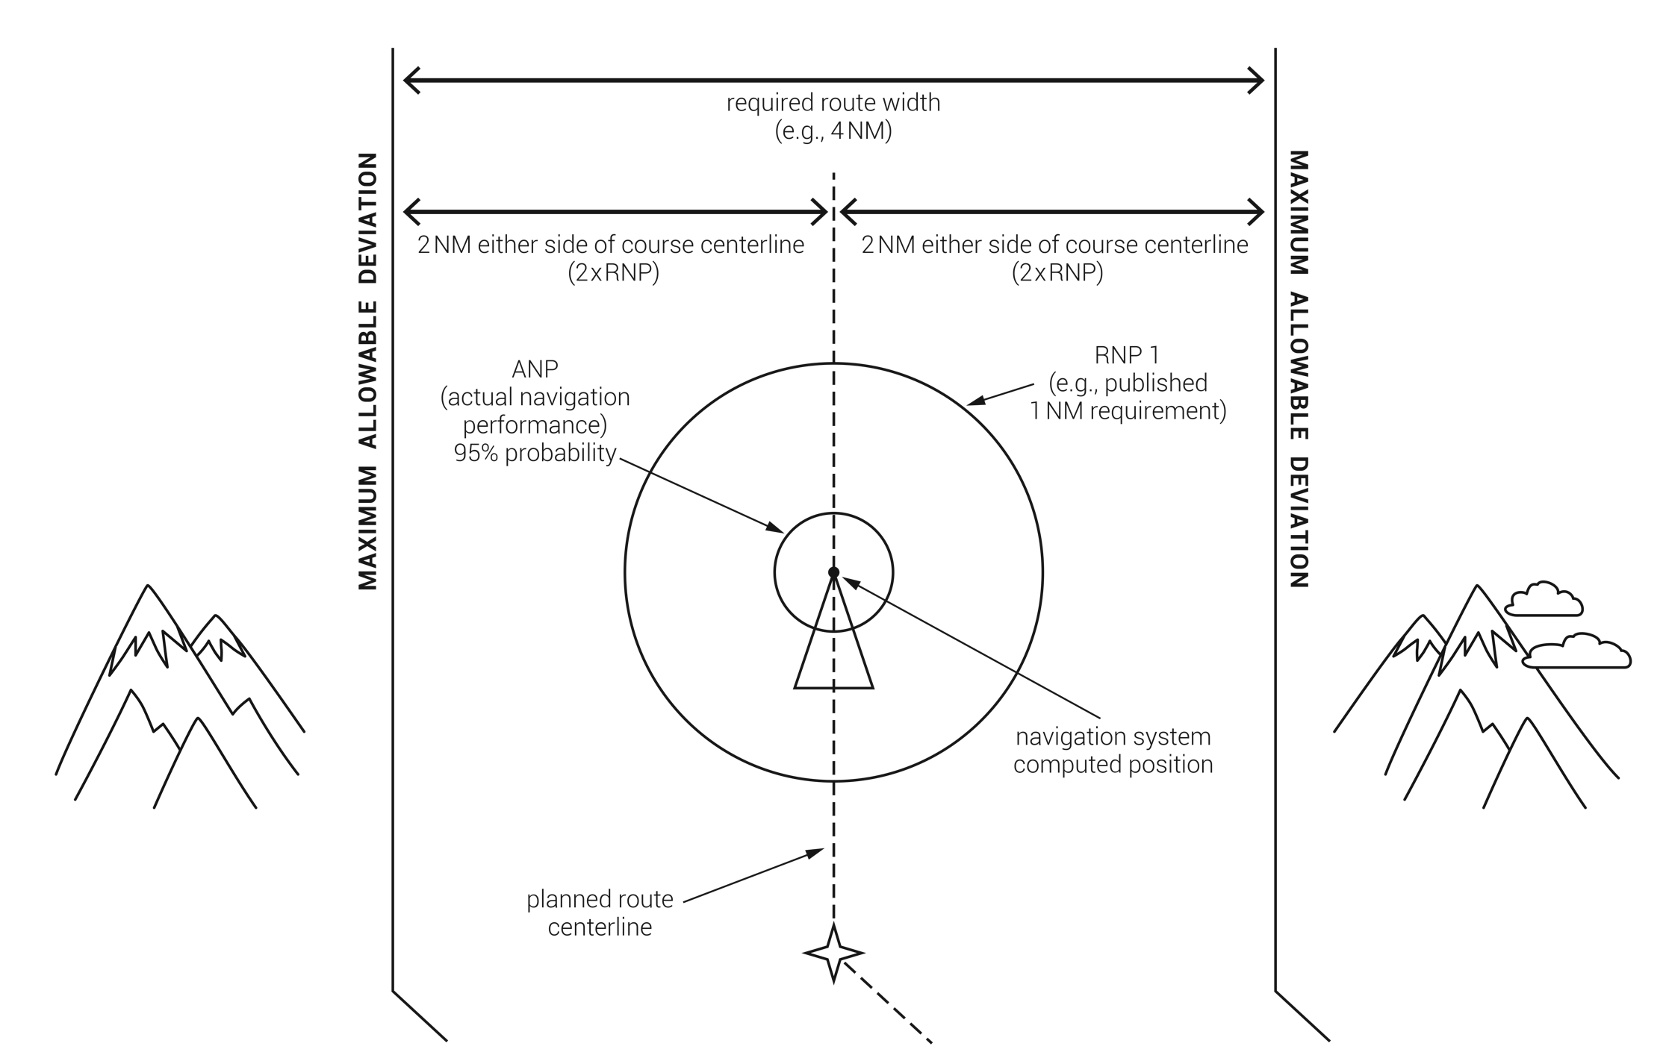
RNP looks at allowable maximum course deviation from route centerline. This allowable deviation is usually set at 50% of the distance from course centerline to maximum allowable. Required width changes depending on minimum terrain clearance, noise abatement, arrival/departure parameters or other criteria.
FIGURE 13.11
Required navigation performance (RNP) vs. actual navigation performance (ANP).

Slide 15
FIGURE 13.12
Receiver autonomous integrity monitoring (RAIM).

Slide 16
CATEGORY | A | B | C | D
LPVDA | 227-1/2 200 (200 - 1/2) (height and vis)
LNAV/VNAV DA | 363 - 3/4 336 (400 - 3/4)
LNAVMDA | 480 - 3/4 453 (500 - 3/4) |  | 480 - 7/8 453 (500 - 7/8)
CIRCLING MDA | 520 - 1 491 (500 - 1) |  | 520 - 1 1/2 640 – 2 491 (500 - 1 1/2) 611 (700 - 2)
FIGURE 13.13
Typical RNAV approach minima table.

Slide 17
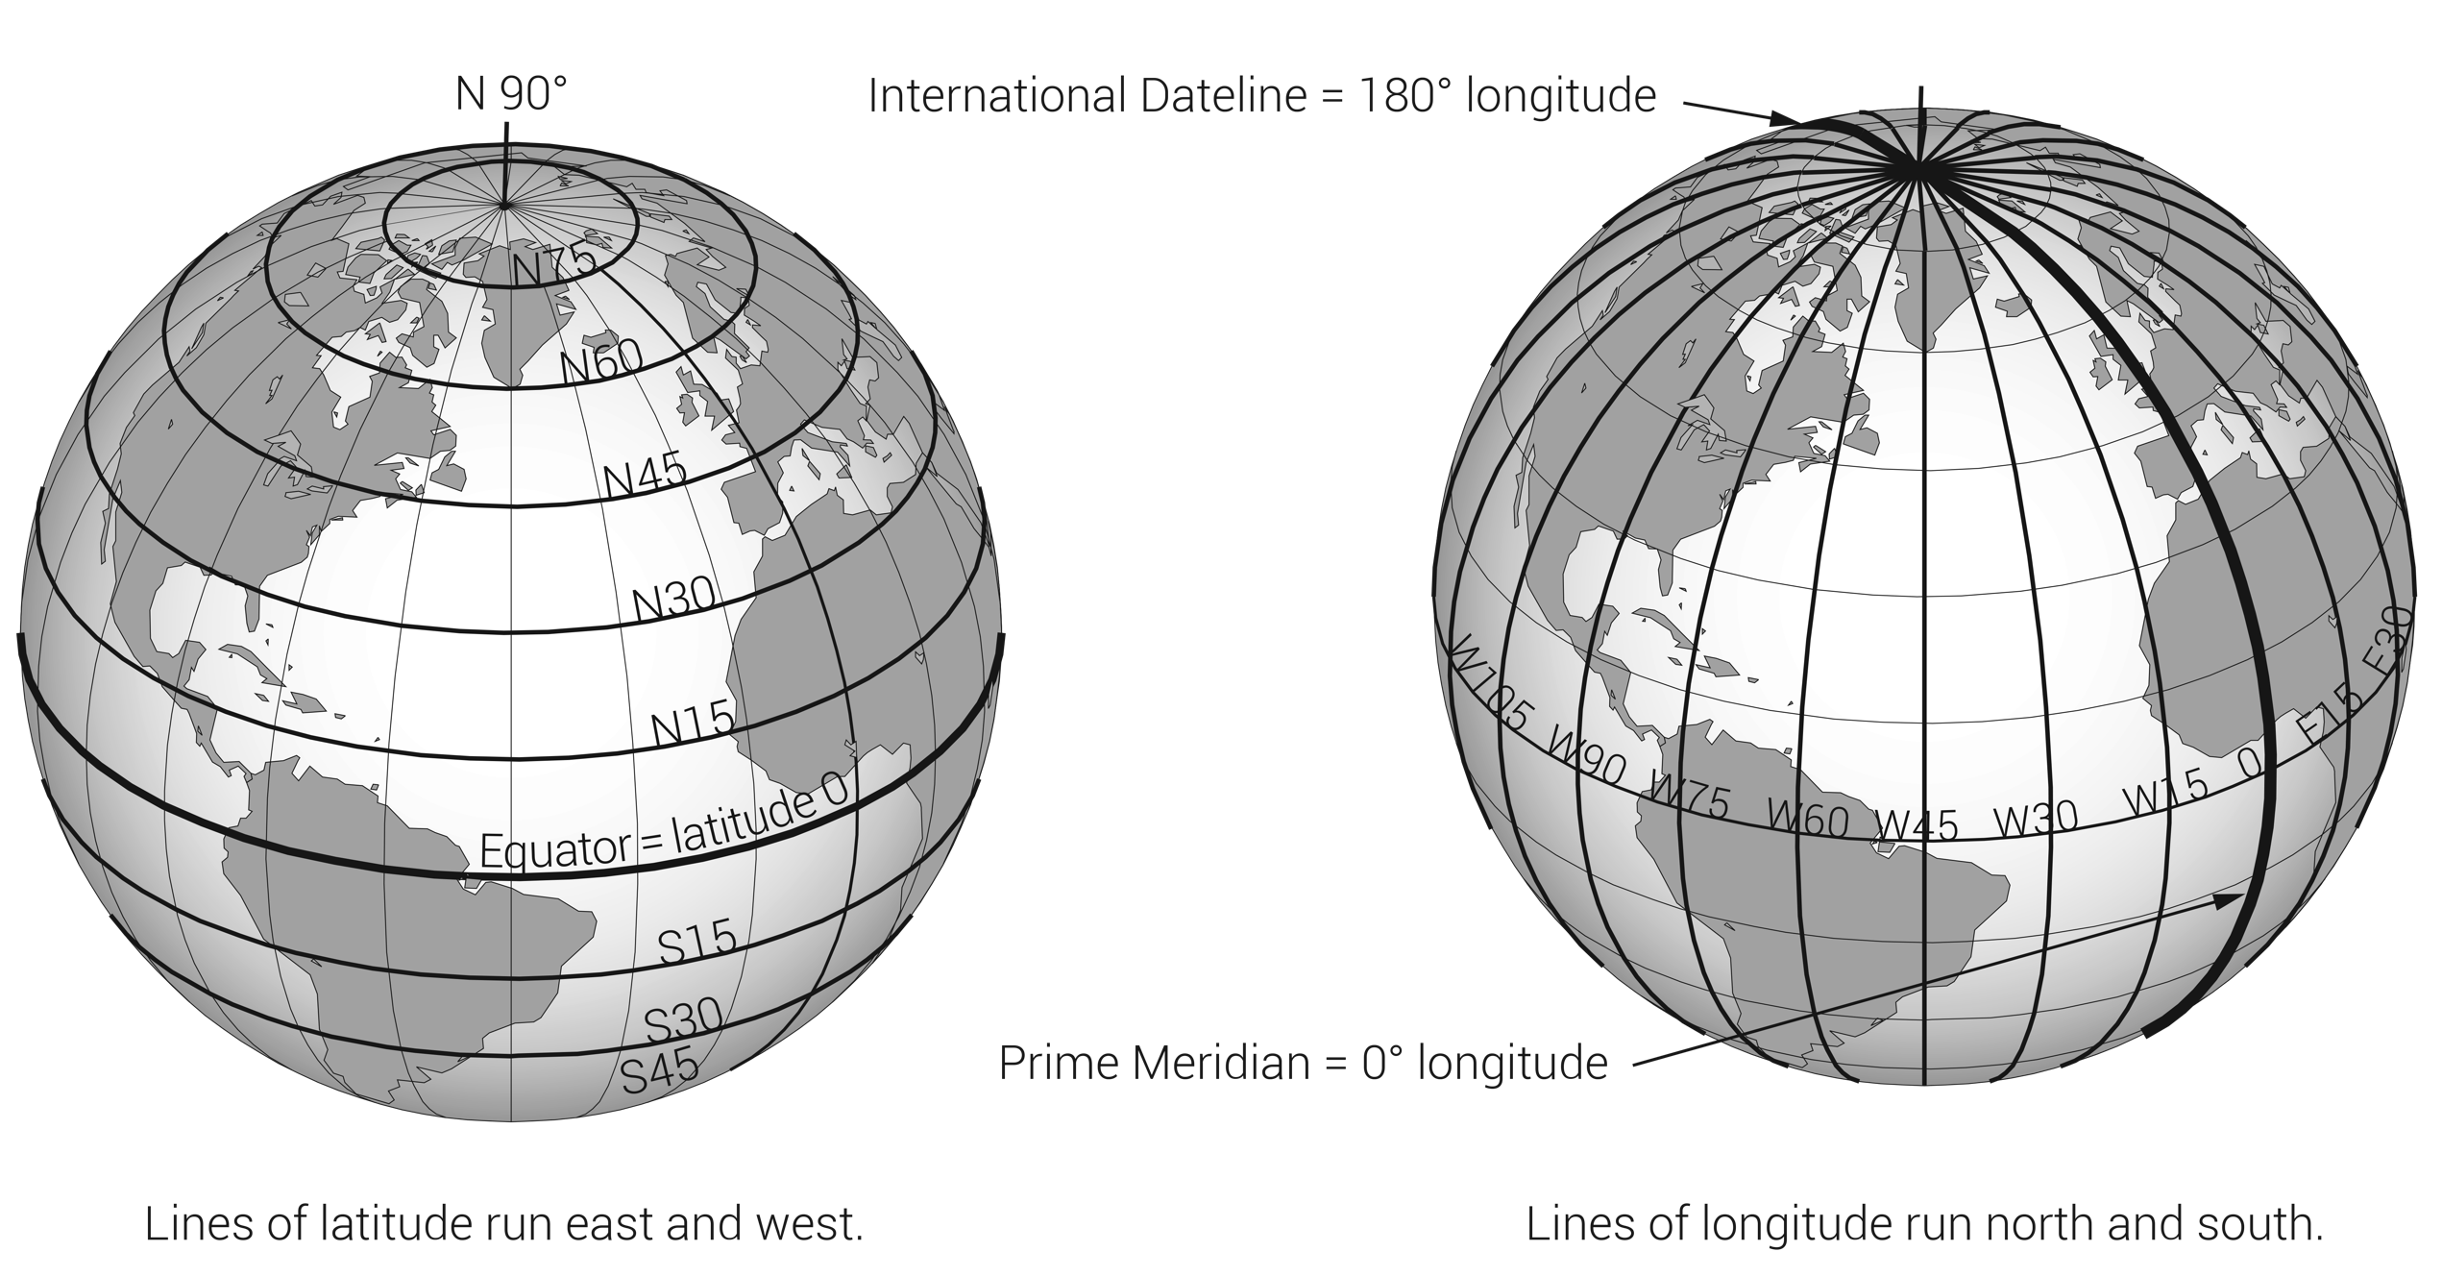
FIGURE 13.14
Longitude and latitude on the globe.

Slide 18
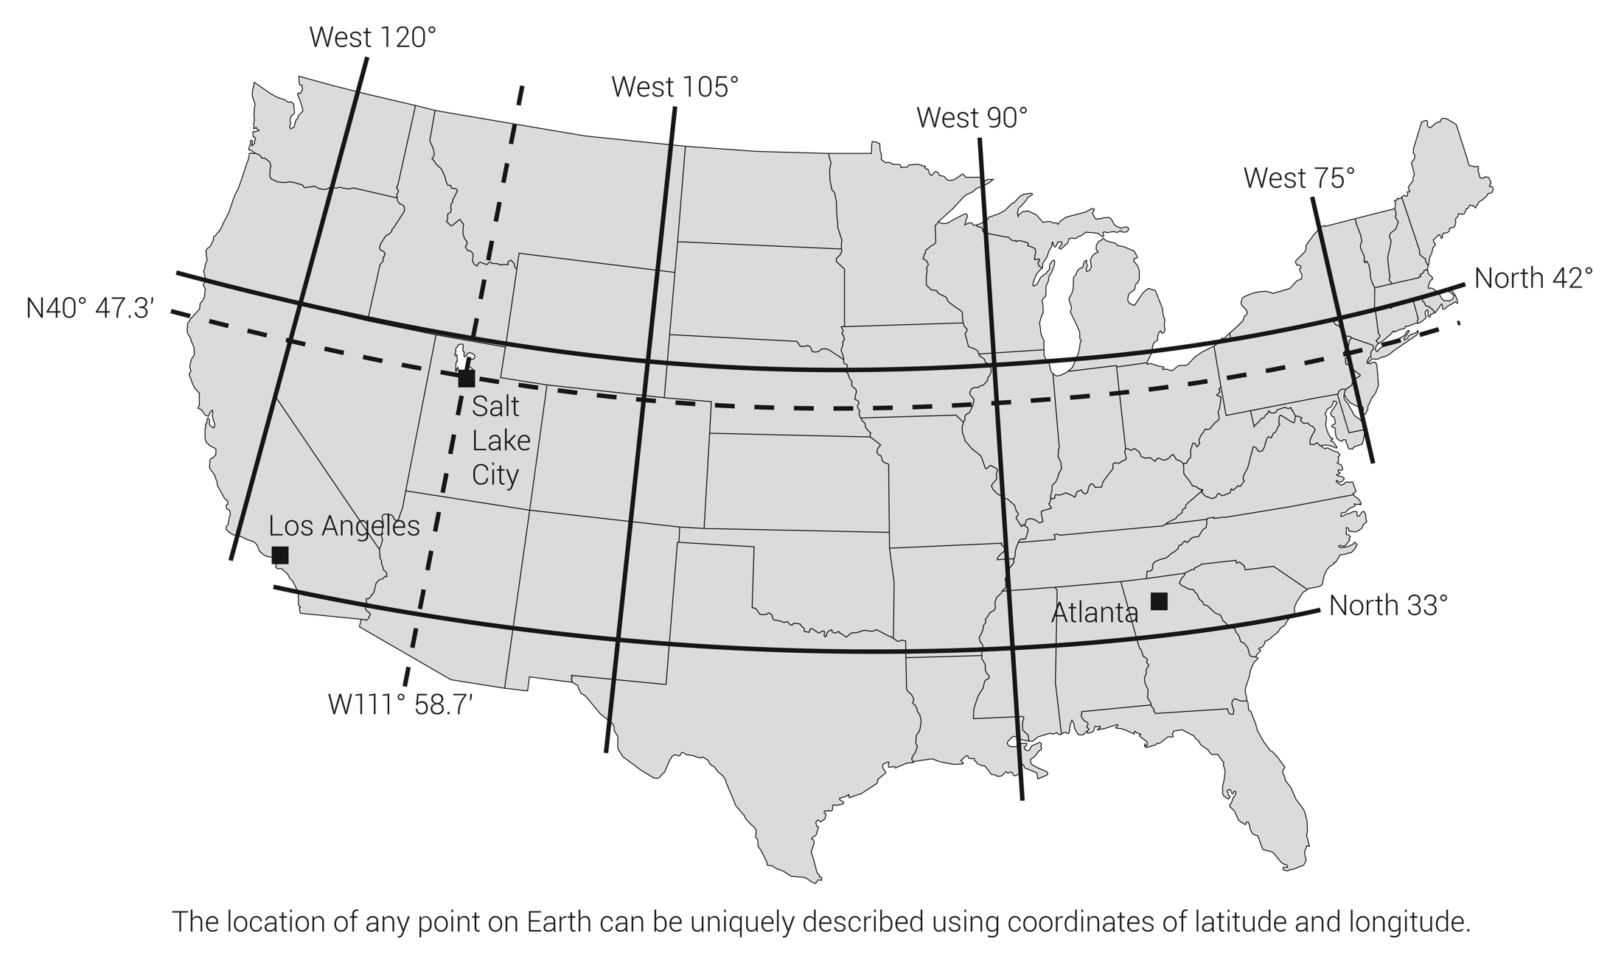
FIGURE 13.15
Latitude/longitude plotted on a map of the continental U.S.

Slide 19
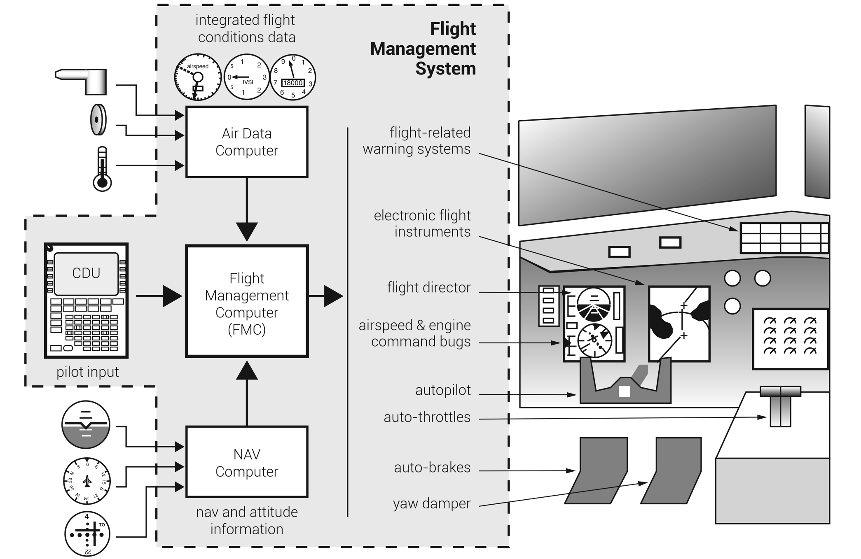
A flight management system (FMS) integrates operating and flight planning parameters to automatically fly the airplane under flight crew guidance. (Details vary widely by specific installation.)
FIGURE 13.16
Flight management system (FMS) components.

Slide 20
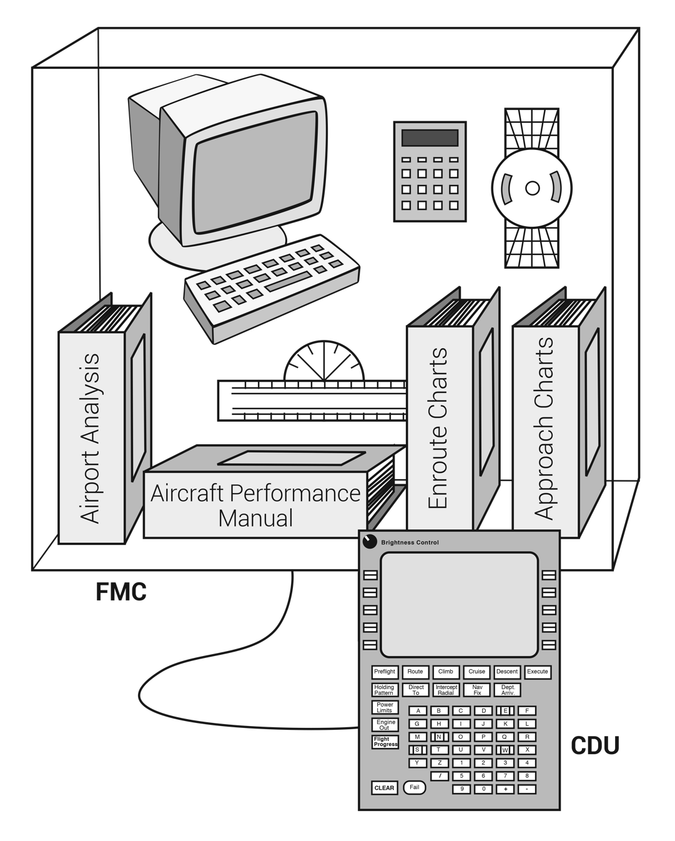
FIGURE 13.17
Flight management computer (FMC).

Slide 21
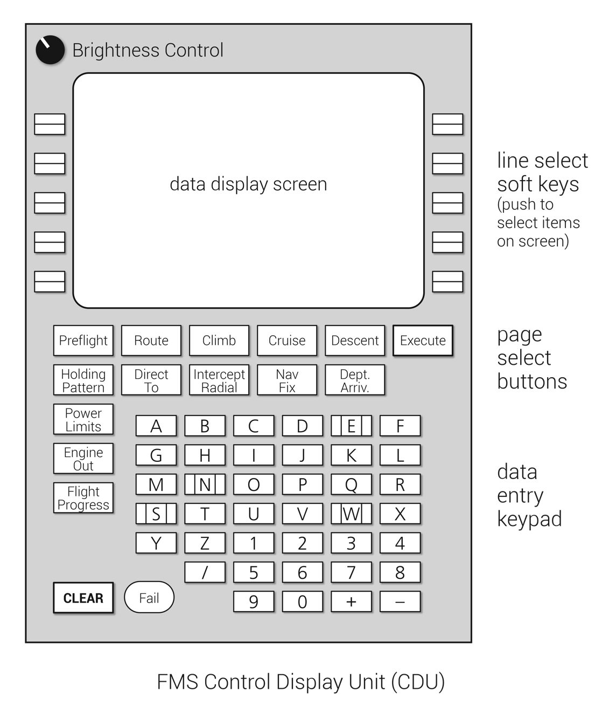
FIGURE 13.18
Control display unit (CDU).

Slide 22
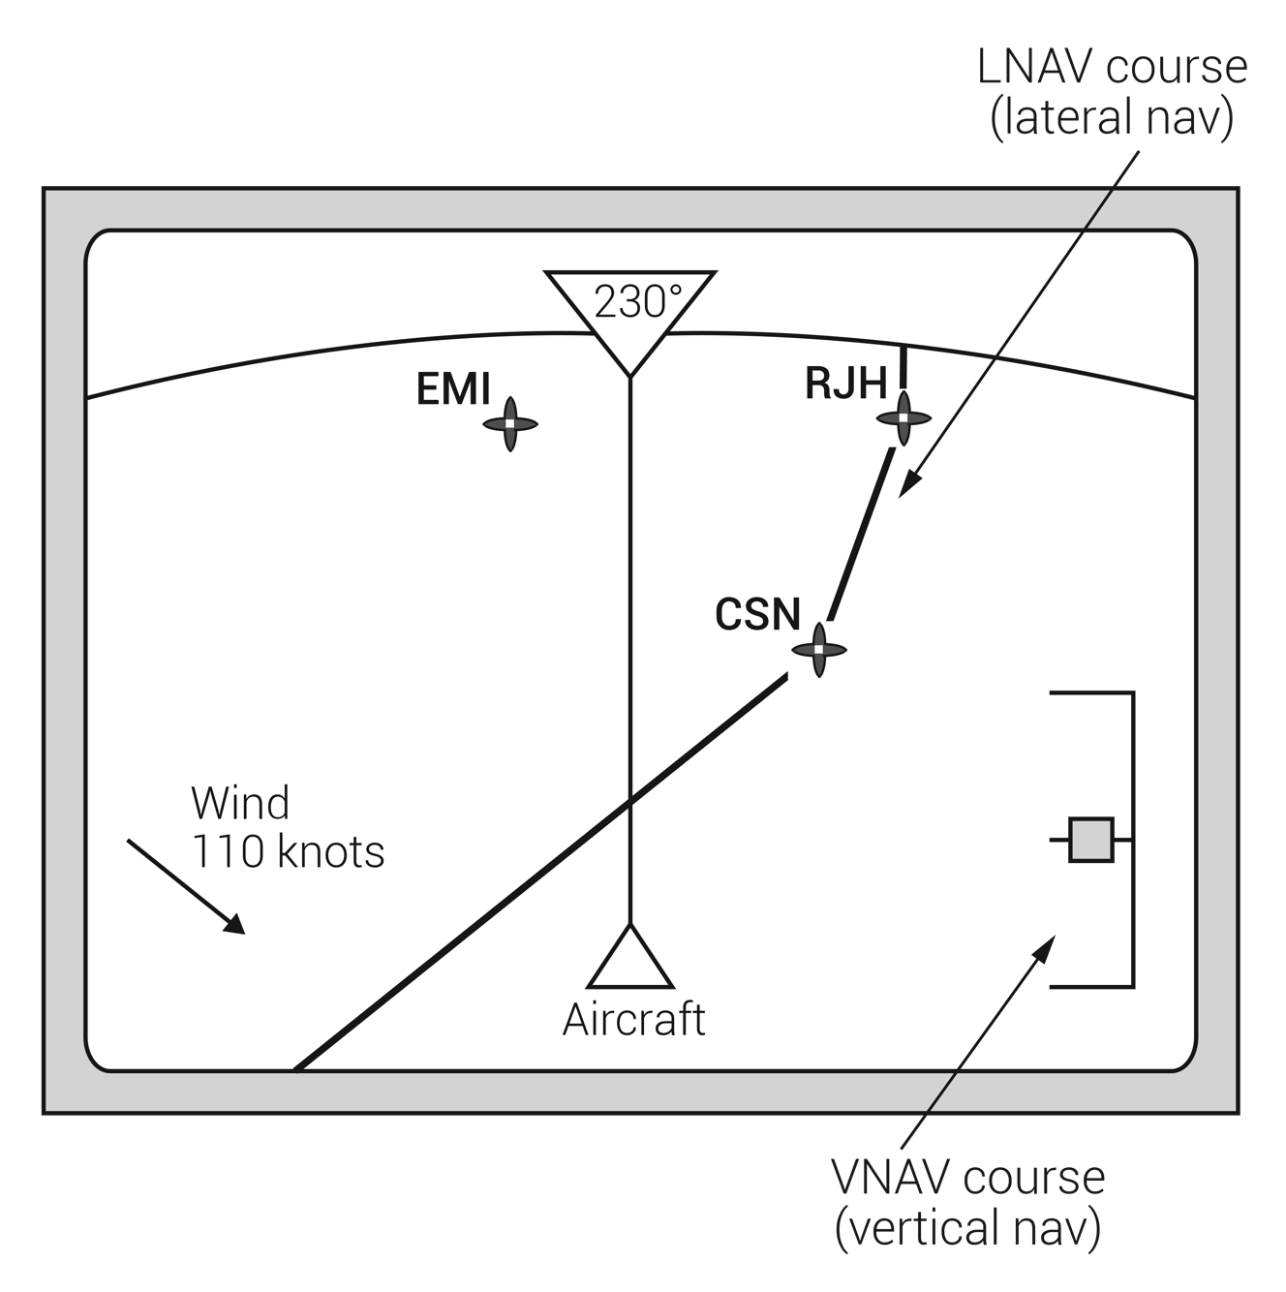
FIGURE 13.19
EFIS moving map display of lateral and vertical navigation.

Slide 23
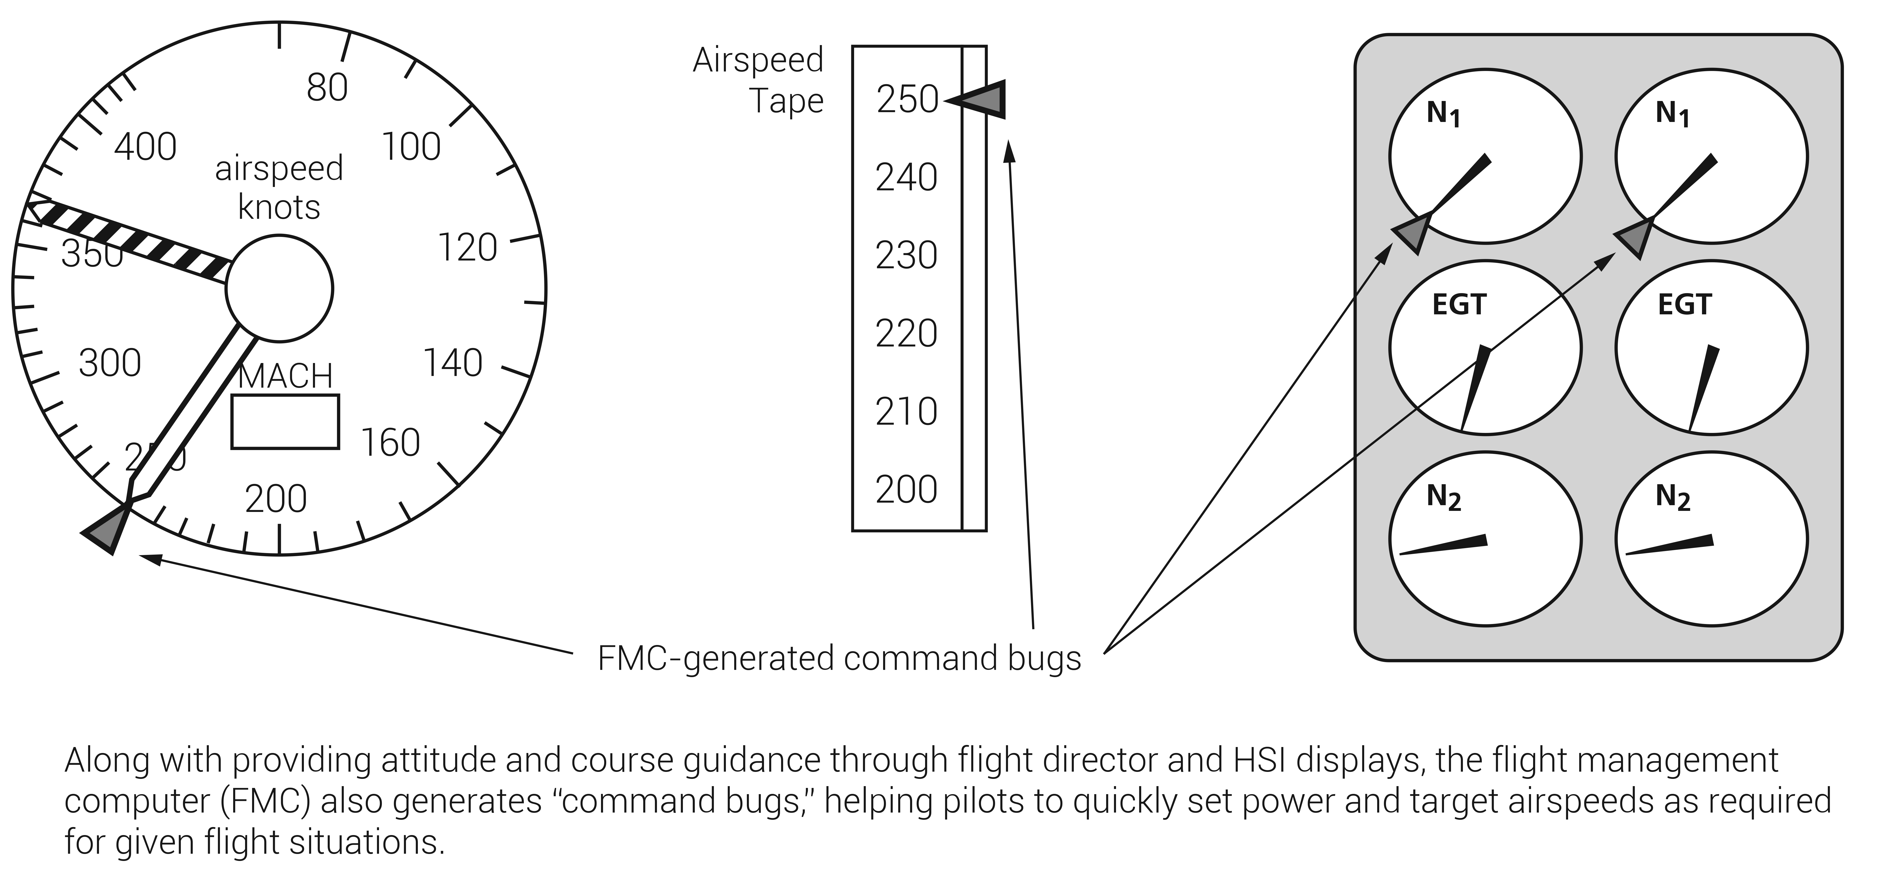
FIGURE 13.20
FMC-generated command markers.

Slide 24
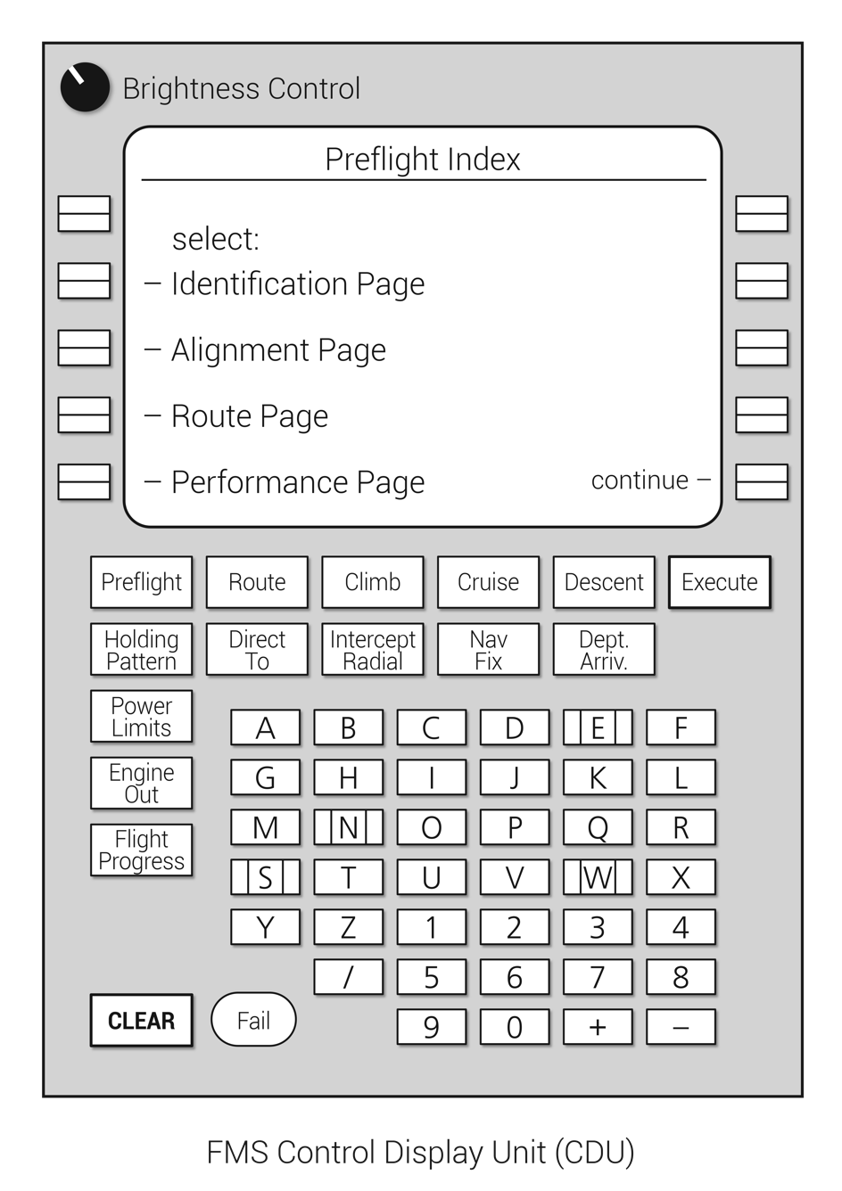
FIGURE 13.21
FMS preflight contents page.

Slide 25
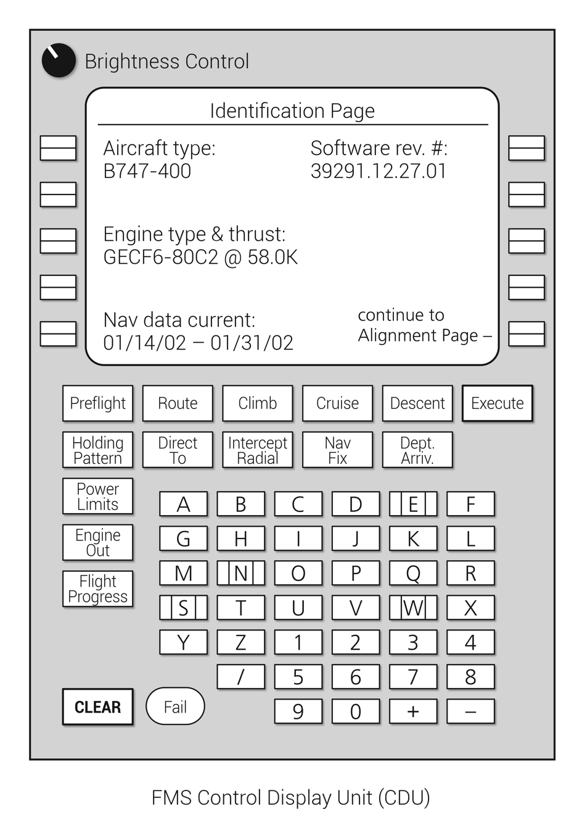
FIGURE 13.22
FMS identification page.

Slide 26
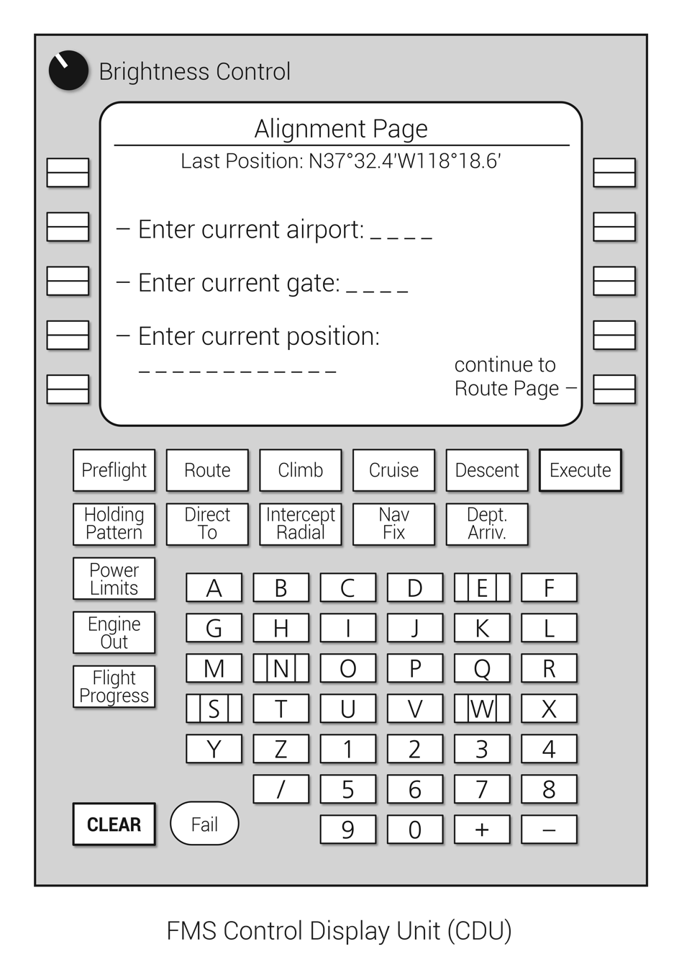
FIGURE 13.23
FMS alignment page.

Slide 27
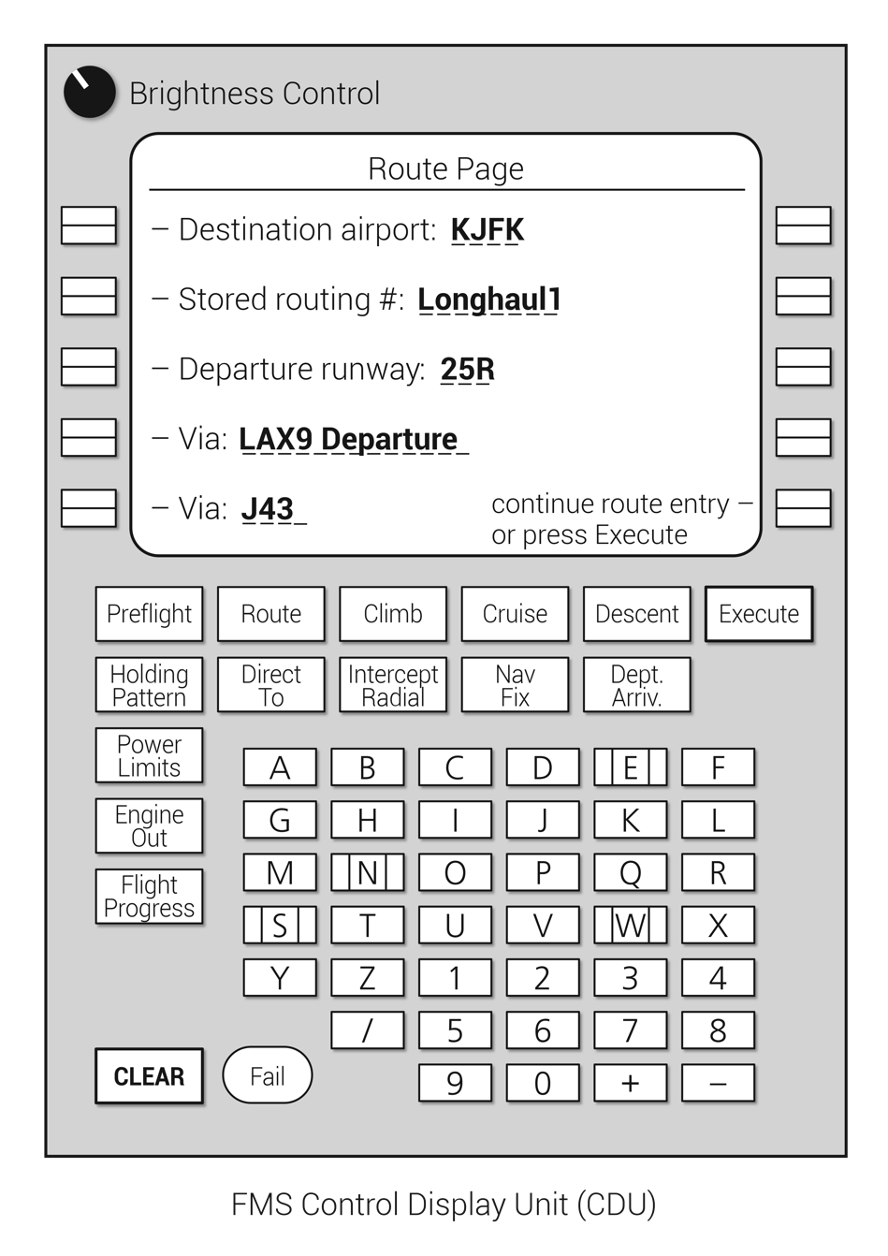
FIGURE 13.24
FMS route page.

Slide 28
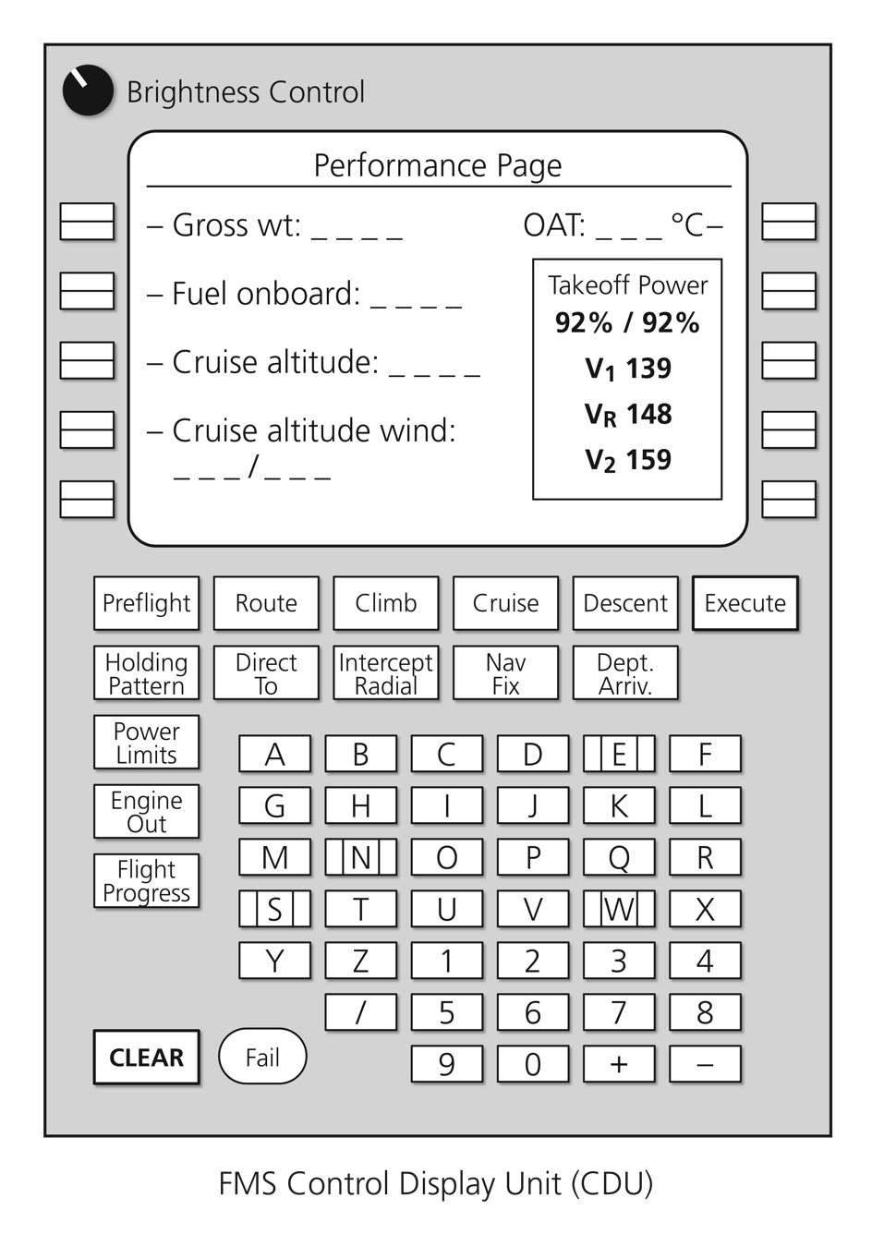
FIGURE 13.25
FMS performance page.

Slide 29
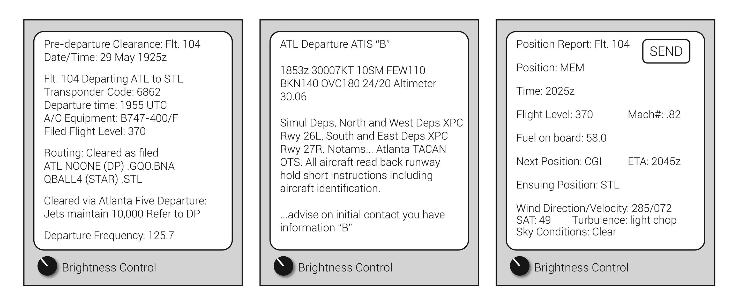
FIGURE 13.26
Typical ACARS communications pages.

Slide 30
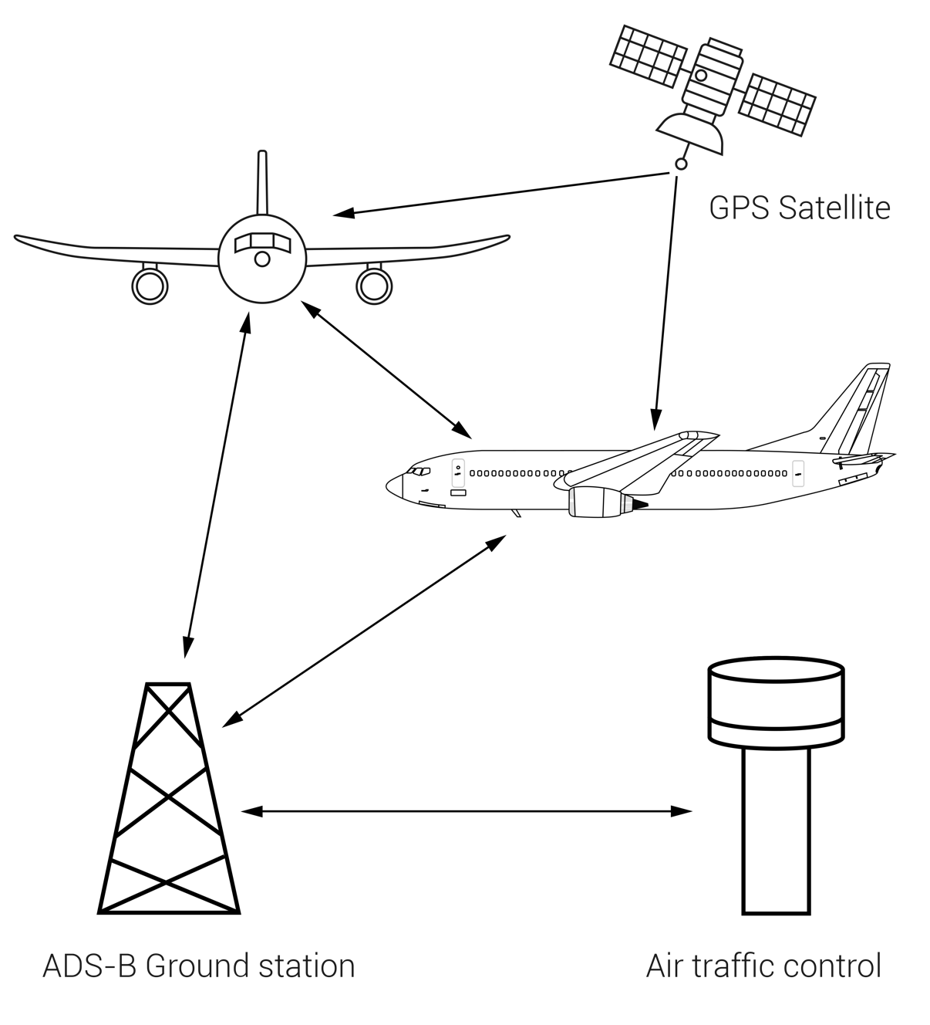
FIGURE 13.27
ADS-B network.

